Slide 1
A real-time speech recognition system on smart glasses for people with hearing difficulties 修士論文発表
15646146 Satjapong meeklai
金子研究室
2017/02/06

Slide 2
Background
360 million people worldwide have disabling hearing loss (2015)
(source: http://www.who.int/mediacentre/factsheets/fs300/en/)
Students with hearing difficulties are having hard time participating in the same classes with normal students
(source: R. Ranchal, T. Taber-Doughty, Y. Guo, K. Bain, H. Martin, J.P. Robinson, B.S. Duerstock, "Using Speech Recognition for Real-Time Captioning and Lecture Transcription in the Classroom, IEEE Transactions on Learning Technologies, vol. 99, pp. 299-311, 2013)
Everyone who has hearing difficulties have experienced a lot of troubles in living with normal people
(source: http://gizmodo.com/5912623/being-deaf)

Slide 3
Previous researches
Wald, M., & Bain, K. (2007, July). Enhancing the usability of real-time speech recognition captioning through personalised displays and real-time multiple speaker editing and annotation. In International Conference on Universal Access in Human-Computer Interaction (pp. 446-452). Springer Berlin Heidelberg.

Slide 4
Research purpose
Creating a real-time speech recognition system to stream captions to smart glasses in real time for people with hearing difficulties with following goals:
Captions have acceptable levels of accuracy and delay in situations where only one person speaks at a time
No voice training profiles and captions correction by human are needed
With helps from the system, people with hearing difficulties can achieve certain level of understandability in the same level or slightly less than normal people within accetable delay

Slide 5

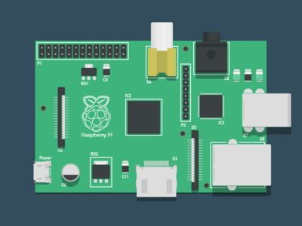


System Design
Speeches
Speaker
The system
Captions
People with hearing difficulties

Slide 6

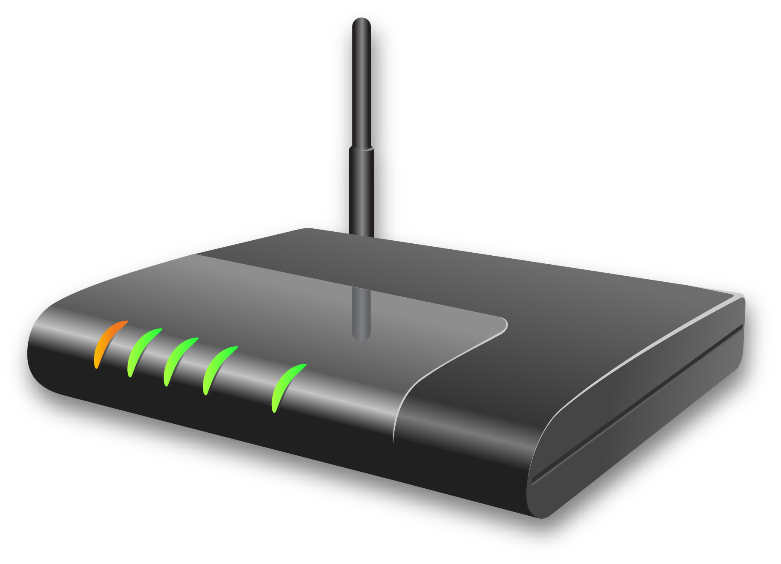
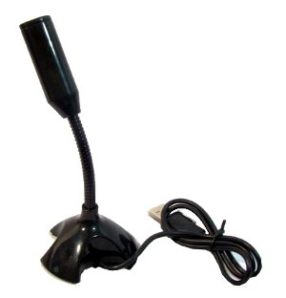
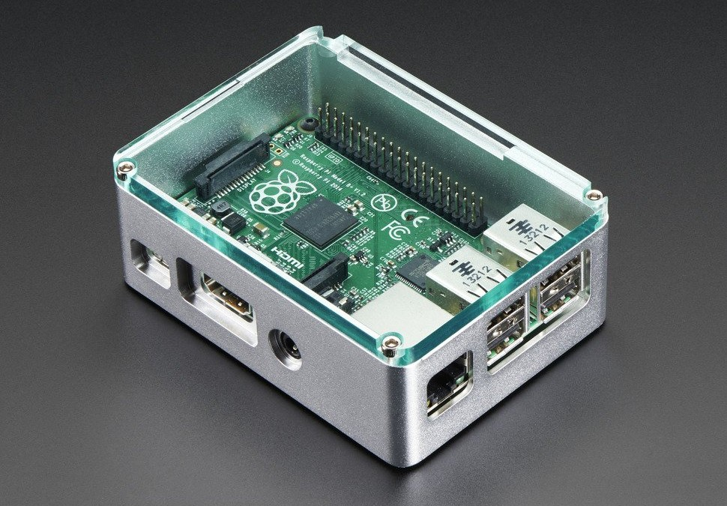
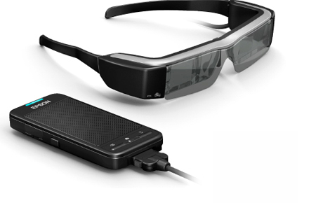
SYSTEM ARCHITECTURE
Google Speech API
Network
Captions
Captions
Audio Data
Microphone
Raspberry PI 2 Model B
(with USB WiFi adapter)
EPSON BT-200

Slide 7

Software ARCHITECTURE
What happens inside Raspberry PI 2 Model B?
Real-time speech recognition
Caption Creating Process
Bytes
Transcripts
Captions
Python Speech Recognition 3.4.6 library
Audio data
from microphone
EPSON BT-200
(runs on Android 4.0.4)
Improved version of
Python Speech Recognition 3.4.6

Slide 8
SYSTEM Implementation
Hardware requirements:
Raspberry PI 2 Model B (Microcontroller)
Logicool HD Pro Webcam C910 (USB microphone module)
Billion 5200W-TR2 (Wireless router)
I-O DATA WN-G300UA (USB WiFi Adapter)
EPSON Moverio BT-200 (Smart glasses)
Software requirements:
Python 2.7
PyAudio library
Python speech recognition version 3.4.6 library
Java sdk 1.8
Android sdk (API level 15)

Slide 9
Python Speech Recognition 3.4.6
A library for performing speech recognition on Python
Supporting several speech recognition engines/API such as Google Speech Recognition, IBM Speech to Text, and Microsoft Bing Voice Recognition
Support several languages (Also support Japanese)
Automatically adjusting ambient noise
Easy to use
Best of all, it’s open source!

Slide 10
Python Speech Recognition 3.4.6
Drawbacks of the service
Doesn’t perform speech recognition until a speech is finished
The longer a speech is, the longer time uses
Interim results are not available

Slide 11
Real-time speech recognition
Requirements that need to be fulfilled (own ideas)
Receiving and streaming interim results continuously
The correctness of interim results and captions are understandable and consistent to the speech
Using the best available speech recognition engine/API
Able to define the end of speeches
Listen to speakers continuously in background

Slide 12
Real-time speech recognition
Comparison of speech recognition services (speed)

Slide 13
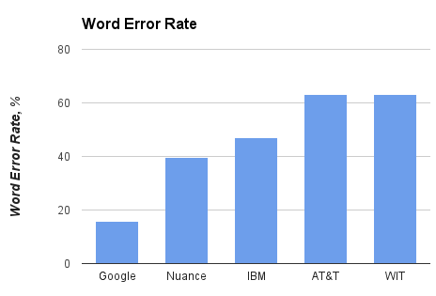
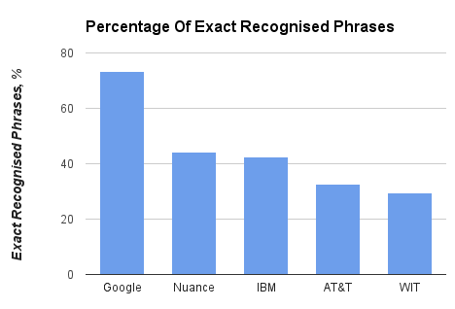
Real-time speech recognition
Comparison of speech recognition services (accuracy)
Google achieved 73.3% of exact recognized phrases with a 15.8% WER

Slide 14
Real-time speech recognition
Sub-thread 1
2 seconds of audio data (from the start)
4 seconds of audio data (from the start)
Main Thread
Sub-thread 2
Completed audio data
Sub-thread n
(Final thread)
2 seconds
4 seconds
n seconds
A speaker start speaking
The speaker stop speaking
Main Thread
Listening users continuously in background
Managing and preparing audio data for sub-threads
Creating captions from transcripts
Managing and sending captions to smart glasses
Sub-threads
Sending audio data and handling responses from Google speech recognition service
Notes:
Anyway, google speech recognition is a software as a service. It’s not designed to process incoming input and give output simultaneously. In order to solve this issue, we optimize the library with the concept of multithreaded programming. This slide will give you an idea of how does the optimized version of the library work…

Slide 15
Real-time speech recognition
Main thread flow chart
Listen to surroundings for a second, calculate the engergy of the surroundings and set it as an ambient noise
Continue to listen and calculate the energy of surroundings
If the energy of the surroundings rises significantly compared to the ambient noise, start recording
While recording, split the recorded audio every two seconds, and then creat a sub-thread with an instance of the recorded audio data
Receive a list of transcripts from the sub-thread (interim results)
Create or update the uncompleted caption (caption creating process), and then send it to smart glasses
If the energy of the surroundings still doesn’t fall below the ambient noise, keep repeating steps 4, 5 and 6

Slide 16
Real-time speech recognition
Main thread flow chart
If the energy of the surroundings falls below the ambient noise, create a final thread with an instance of completed audio data.
Receive a list of transcripts from the final thread
Finalize the caption (caption creating process) , and then send to smart glasses
Go back to step 2 and keep continuing until the system is existed

Slide 17
Real-time speech recognition
Workflow of a sub-thread
Sub-threads
Google Speech Recognition
Voice Data (FLAC)
Responses (JSON)

Slide 18
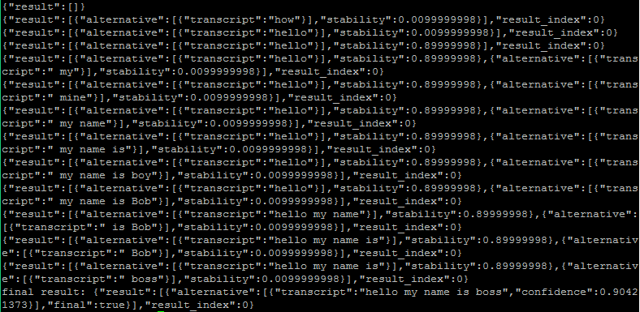
Real-time speech recognition
A list of transcripts returned from Google speech recognition service

Slide 19

Real-time speech recognition
Caption creating and managing process
Sub-thread n (Final thread)
Sub-thread 1
Sub-thread 2
Response from 0-2 seconds
Response from 0-4 seconds
Response from 0-2n seconds
Main thread

Slide 20
Real-time speech recognition
Caption creating algorithm (Main thread)
Getting JSON response from sub-threads
Reading a row in responses (interim results)
Taking the first transcript from the row
If the length of current caption < the transcript
Update the current caption with the transcript
Keep repeating step 2 to 4 until “final = true” is found
Replace the whole caption with the final transcript

Slide 21
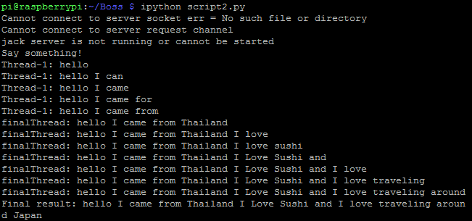
Real-time speech recognition
Real-time results from caption creating function

Slide 22

Graphic user interface
Standby screen

Slide 23
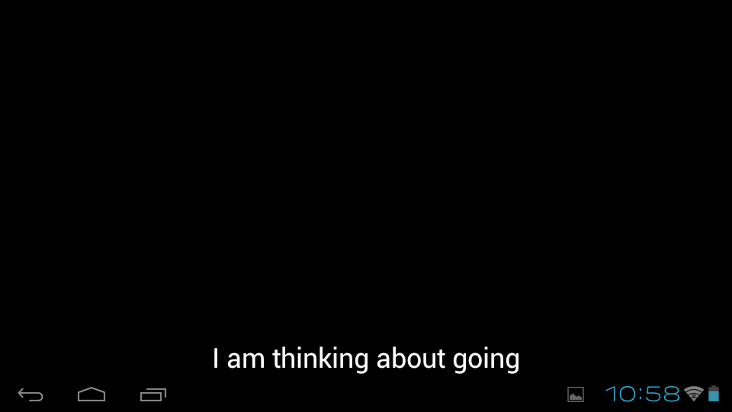
Graphic user interface
An uncompleted caption created from interim results of the first sub-thread

Slide 24
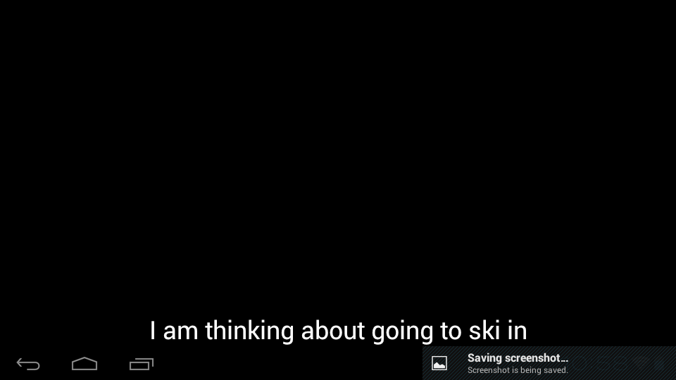
Graphic user interface
The caption is updated with newer interim results from a newer sub-thread

Slide 25

Graphic user interface
The caption is finalized with the result from the final thread

Slide 26
Experiment
We evaluated the system in three aspects
System performance
System effectiveness
System usability
Experimental method
Two datasets included two different topics of videos and quizzes are prepared
22 physically complete non-native English speakers joined
Controlled group (represents people with hearing difficulties)
Using the system, watching the mute video and answering the quiz
Uncontrolled group (represents normal people)
Not using the system, watching the unmute video and answering the quiz

Slide 27
Evaluation
System performance
Notes:
Avg 77.19%

Slide 28
Evaluation
System performance
Notes:
Avg 4.88
Sd avg 0.72

Slide 29
Evaluation
System effectiveness
 | Uncontrolled Group | Controlled Group | Difference | P-value (t-test)
Average level of understanding | 4.86 (81%) out of 6 | 4.14 (69%) out of 6 | 0.45 points (12% lower) | 0.0559 (not quite statistically significant)
Average time used | 119.41 seconds | 143.27 seconds | 23.86 seconds (19.98% slower) | 0.0194 (statistically significant)

Slide 30
Evaluation
System usability
Question | Average score | Standard Deviation
System satisfaction | 3.27 | 1.08
Eyewear comfortableness | 2.68 | 1.09
Font size appropriateness | 3.86 | 1.17
Font color appropriateness | 4.05 | 1.33
Font place appropriateness | 3.77 | 1.19
Caption delay | 3.36* | 1.05
Caption lasting time | 2.82 | 1.18
Caption changing speed | 2.36 | 1.05
Caption understandability | 3.14 | 1.13
5 means the best, 1 means the worst
* 1 means slightly deley, 5 means extreamly delay

Slide 31
Conclusion
The system achieves better accuracy of speech recognition without needs of speaker’s voice training process
No more caption editing by human effort is needed
Multithreaded programming is used to make Google speech recognition works in real-time
The system accomplishes in helping people with hearing difficulties to be able to understand contents of a situation easier and faster
The system aids people with hearing difficulties to achieve slightly inferior level of comprehensibility compared to normal people
However, the system delay and caption changing speed are still unsatisfactory by the users

Slide 32
future works
Multilingual support
Automatic translation
Wireless microphone support
Bi-directional streaming support
Individual settings
Multiple speakers support

Slide 33
